Slide 1
Air Cargo Analysis

Slide 2
Problem Statement Scenario:
Air Cargo is an aviation company that provides air transportation services for passengers and freight. Air Cargo uses its aircraft to provide different services with the help of partnerships or alliances with other airlines. The company wants to prepare reports on regular passengers, busiest routes, ticket sales details, and other scenarios to improve the ease of travel and booking for customers.

Slide 3

Project Objective:
You, as a DBA expert, need to focus on identifying the regular customers to provide offers, analyze the busiest route which helps to increase the number of aircraft required and prepare an analysis to determine the ticket sales details. This will ensure that the company improves its operability and becomes more customer-centric and a favorable choice for air travel.

Slide 4

Dataset description:
Customer: Contains the information of customers
customer_id – ID of the customer
first_name – First name of the customer
last_name – Last name of the customer
date_of_birth – Date of birth of the customer
gender – Gender of the customer
passengers_on_flights: Contains information about the travel details
aircraft_id – ID of each aircraft in a brand
route_id – Route ID of from and to location
customer_id – ID of the customer
depart – Departure place from the airport
arrival – Arrival place in the airport
seat_num – Unique seat number for each passenger
class_id – ID of travel class
travel_date – Travel date of each passenger
flight_num – Specific flight number for each route

Slide 5
ticket_details: Contains information about the ticket details
p_date – Ticket purchase date
customer_id – ID of the customer
aircraft_id – ID of each aircraft in a brand
class_id – ID of travel class
no_of_tickets – Number of tickets purchased
a_code – Code of each airport
price_per_ticket – Price of a ticket
brand – Aviation service provider for each aircraft
Distance_miles – Distance between departure and arrival location
routes: Contains information about the route details
Route_id – Route ID of from and to location
Flight_num – Specific fight number for each route
Origin_airport – Departure location
Destination_airport – Arrival location
Aircraft_id – ID of each aircraft in a brand
Distance_miles – Distance between departure and arrival location

Slide 6
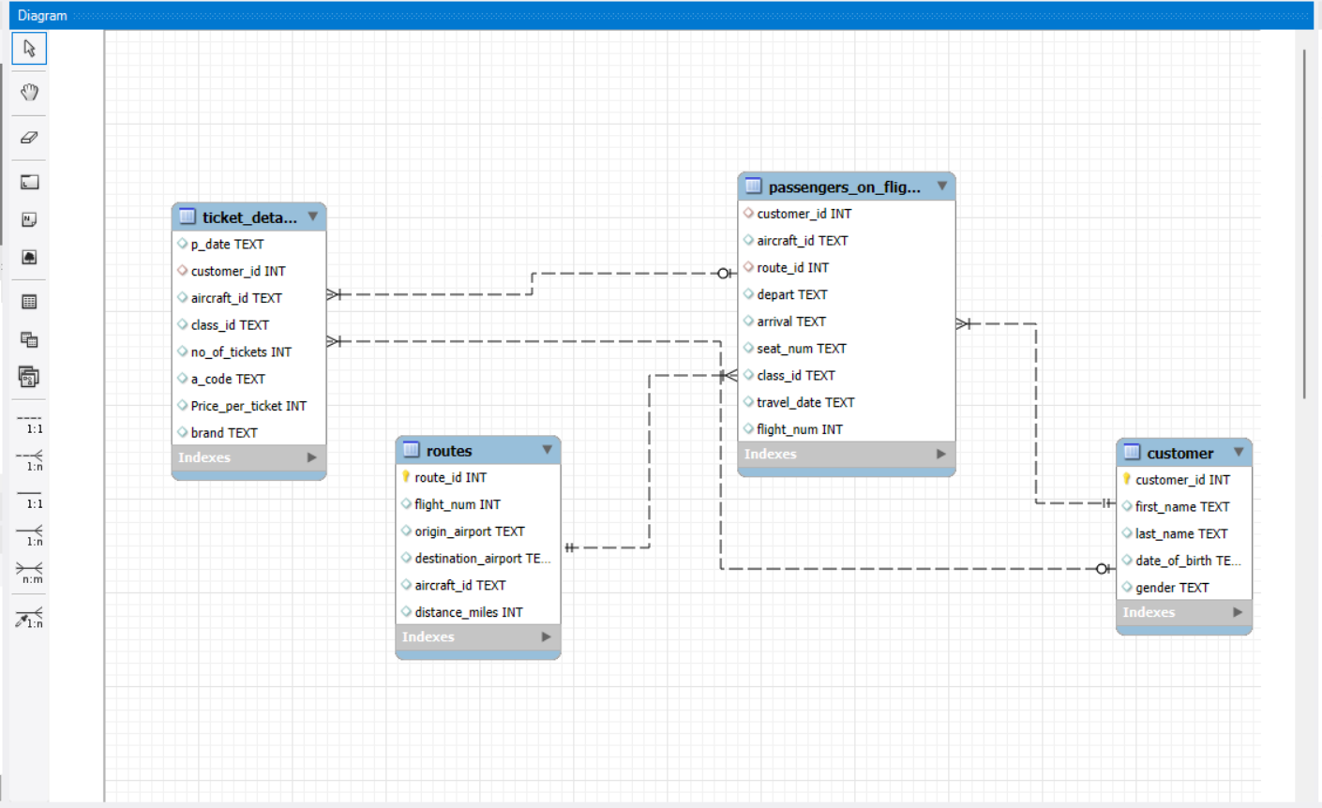
Question: 1
Step 1: Control + r or in Database menu > reverse engineering
Step 2: Making Primary Key to Route_id and customer_id
Step 3: Making Relationships
Create an ER diagram for the given airlines database.

Slide 7
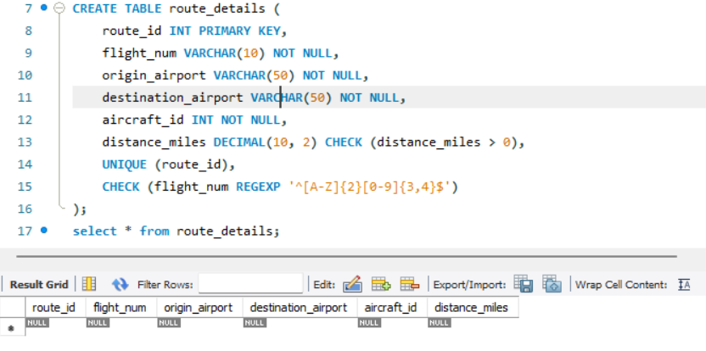
Question: 2
Write a query to create a route_details table using suitable data types for the fields, such as route_id, flight_num, origin_airport, destination_airport, aircraft_id, and distance_miles. Implement the check constraint for the flight number and unique constraint for the route_id fields. Also, make sure that the distance miles field is greater than 0.
Query and Output:

Slide 8

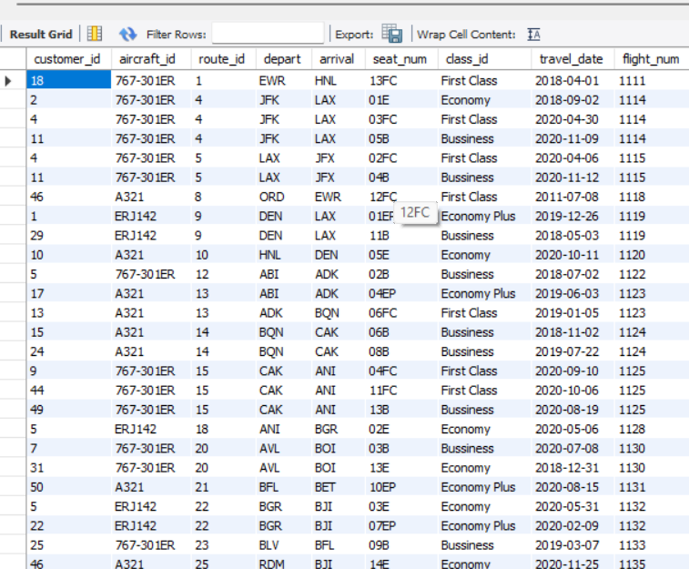
Question: 3
Write a query to display all the passengers (customers) who have travelled in routes 01 to 25. Take data from the passengers_on_flights table.
Query:
Result:

Slide 9
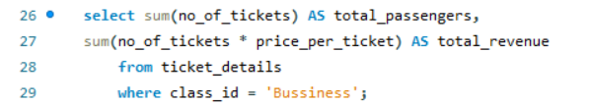
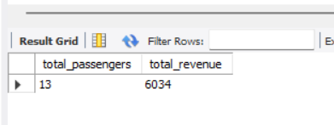
Question: 4
Write a query to identify the number of passengers and total revenue in business class from the ticket_details table.
Query:
Result:

Slide 10

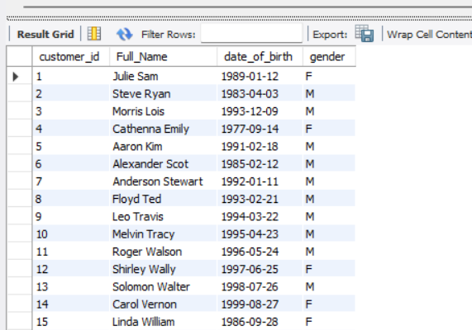
Question: 5
Write a query to display the full name of the customer by extracting the first name and last name from the customer table.
Query:
Result:

Slide 11
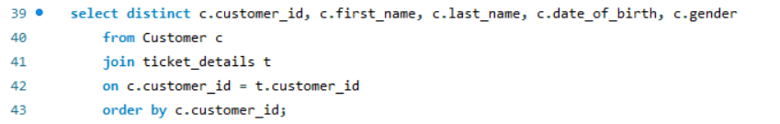
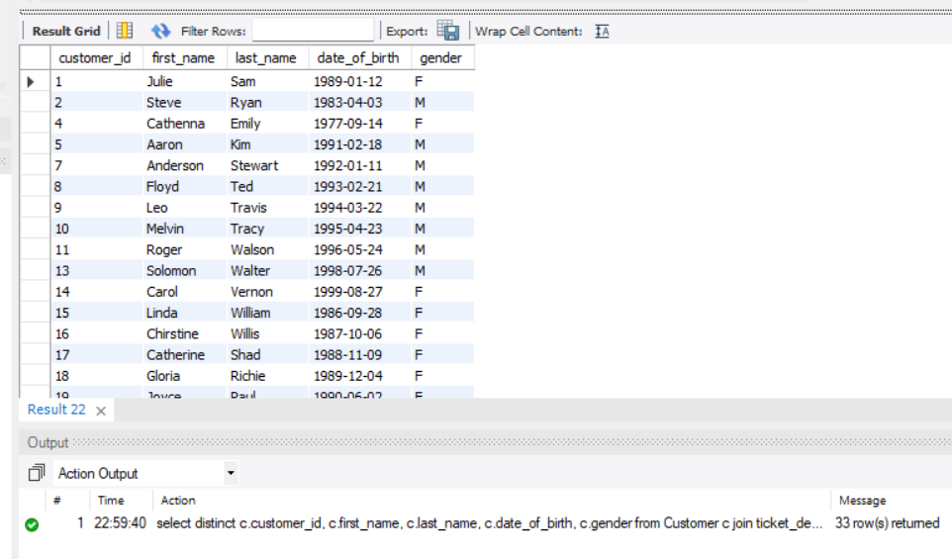
Question: 6
Write a query to extract the customers who have registered and booked a ticket. Use data from the customer and ticket_details tables.
Query:
Result:

Slide 12
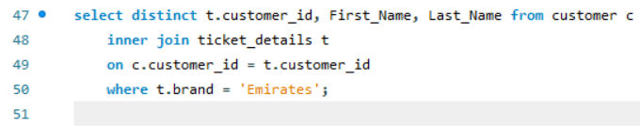
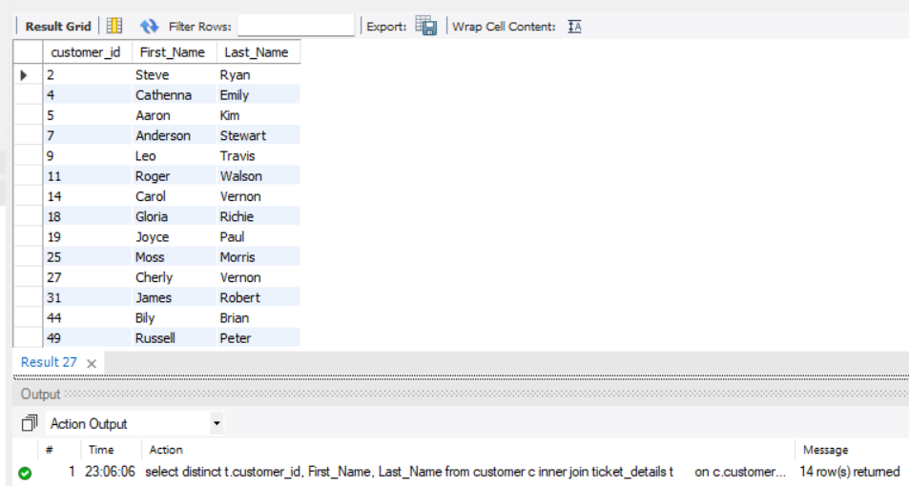
Question: 7
Write a query to identify the customer’s first name and last name based on their customer ID and brand (Emirates) from the ticket_details table.
Query:
Result:

Slide 13
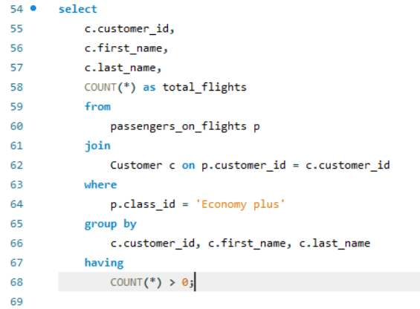
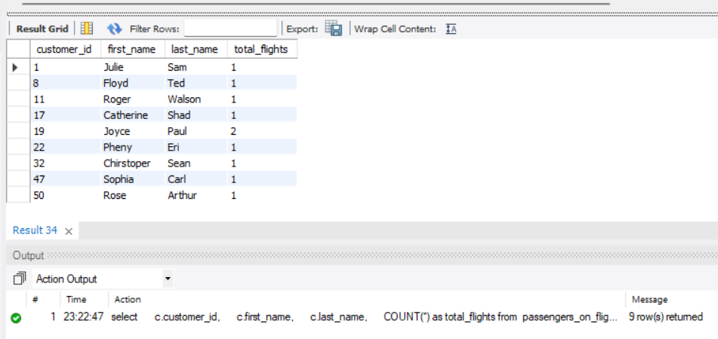
Question: 8
Write a query to identify the customers who have travelled by Economy Plus class using Group By and Having clause on the passengers_on_flights table.
Query:
Result:

Slide 14
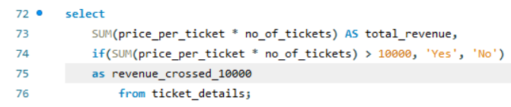
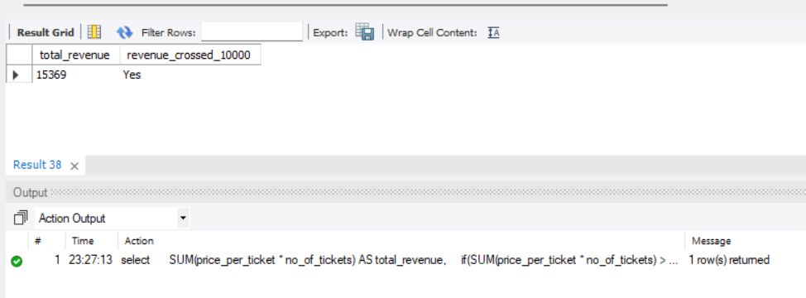
Question: 9
Write a query to identify whether the revenue has crossed 10000 using the IF clause on the ticket_details table.
Query:
Result:

Slide 15

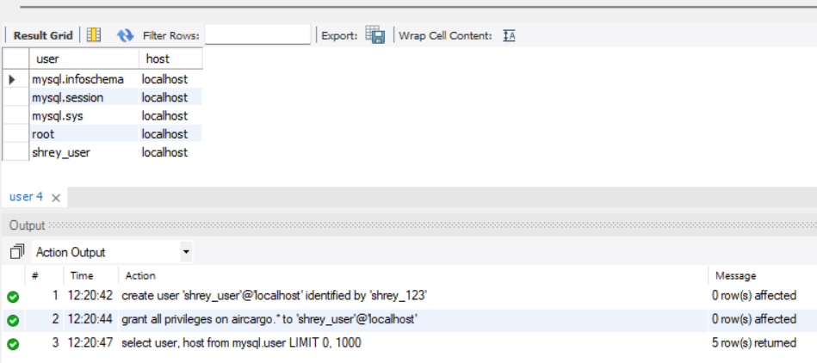
Question: 10
Write a query to create and grant access to a new user to perform operations on a database.
Query:
Result:

